Slide 1
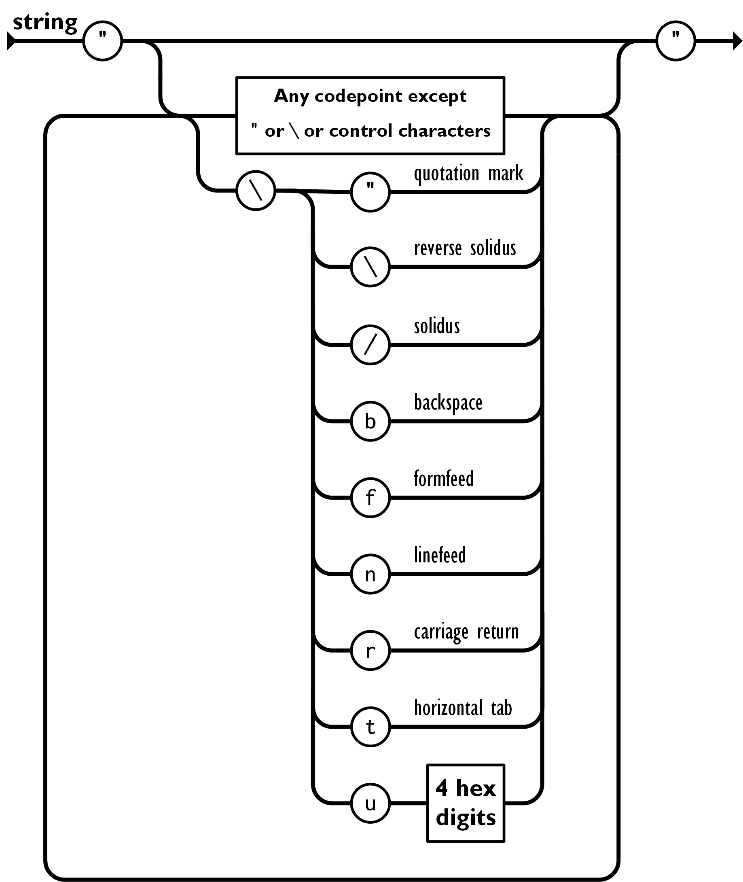

Slide 2
JSON in C++: escaping and serialization
Pavel Novikov
@cpp_ape

Slide 3
Plan for this talk
quick overview of JSON
JSON string escaping
deeper dive into the specification
serialization/stringification

Slide 4
Constraints for this talk
Constraints for the implementation:
follow JSON specification as close as possible
use C++17
write as little code as possible (while maintaining reasonable design and performance)
Not in this talk:
design of a C++ type for working with JSON values
parsing

Slide 5
Overview of JSON
Douglas Crockford specified JSON in the early 2000s.
RFC 8259
null | null
true or false | boolean
3.14 | number
"hello" | string
[ 1, 2, 3 ] | array
{ "key": "value" } | object (dictionary)
primitive types
or
scalar types
structured types
or
collection types

Slide 6
Overview of JSON
JSON-text = ws value ws begin-array = ws %x5B ws ; [ left square bracket begin-object = ws %x7B ws ; { left curly bracket end-array = ws %x5D ws ; ] right square bracket end-object = ws %x7D ws ; } right curly bracket name-separator = ws %x3A ws ; : colon value-separator = ws %x2C ws ; , comma ws = *( %x20 / ; Space %x09 / ; Horizontal tab %x0A / ; Line feed or New line %x0D ) ; Carriage return value = false / null / true / object / array / number / string false = %x66.61.6c.73.65 ; false null = %x6e.75.6c.6c ; null true = %x74.72.75.65 ; true object = begin-object [ member *( value-separator member ) ] end-object member = string name-separator value array = begin-array [ value *( value-separator value ) ] end-array | number = [ minus ] int [ frac ] [ exp ] decimal-point = %x2E ; . digit1-9 = %x31-39 ; 1-9 e = %x65 / %x45 ; e E exp = e [ minus / plus ] 1*DIGIT frac = decimal-point 1*DIGIT int = zero / ( digit1-9 *DIGIT ) minus = %x2D ; - plus = %x2B ; + zero = %x30 ; 0 string = quotation-mark *char quotation-mark char = unescaped / escape ( %x22 / ; " quotation mark U+0022 %x5C / ; \ reverse solidus U+005C %x2F / ; / solidus U+002F %x62 / ; b backspace U+0008 %x66 / ; f form feed U+000C %x6E / ; n line feed U+000A %x72 / ; r carriage return U+000D %x74 / ; t tab U+0009 %x75 4HEXDIG ) ; uXXXX U+XXXX escape = %x5C ; \ quotation-mark = %x22 ; " unescaped = %x20-21 / %x23-5B / %x5D-10FFFF
JSON grammar defined by RFC 8259

Slide 7
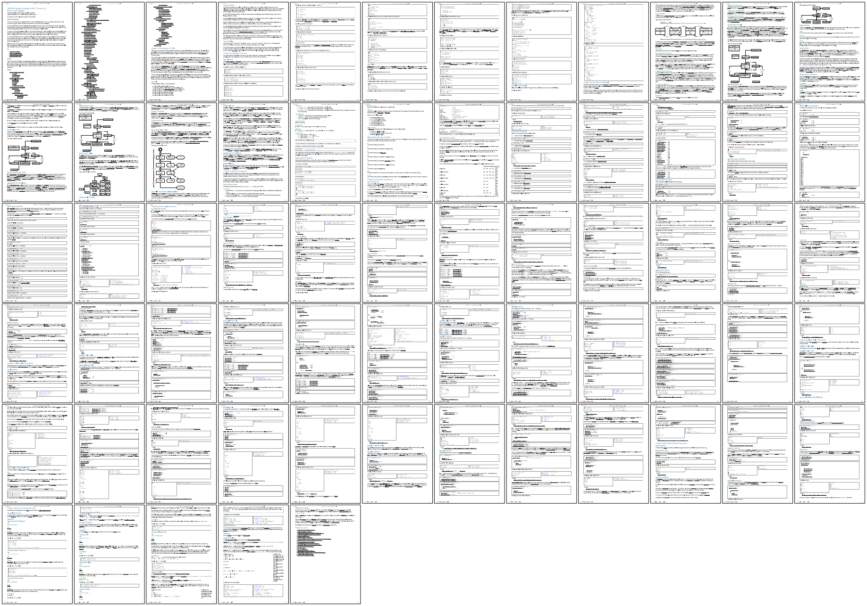
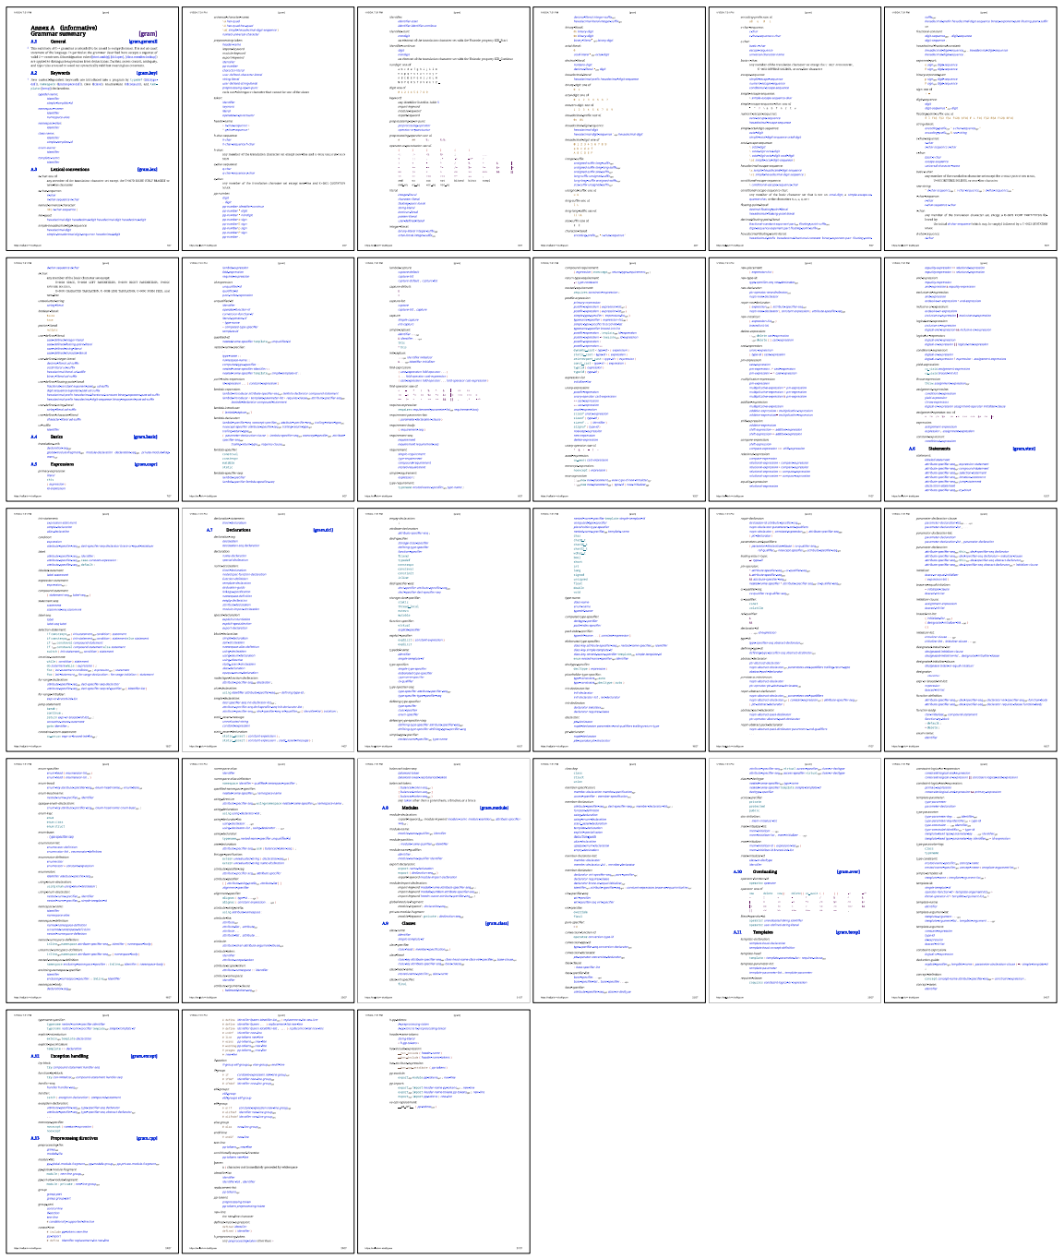
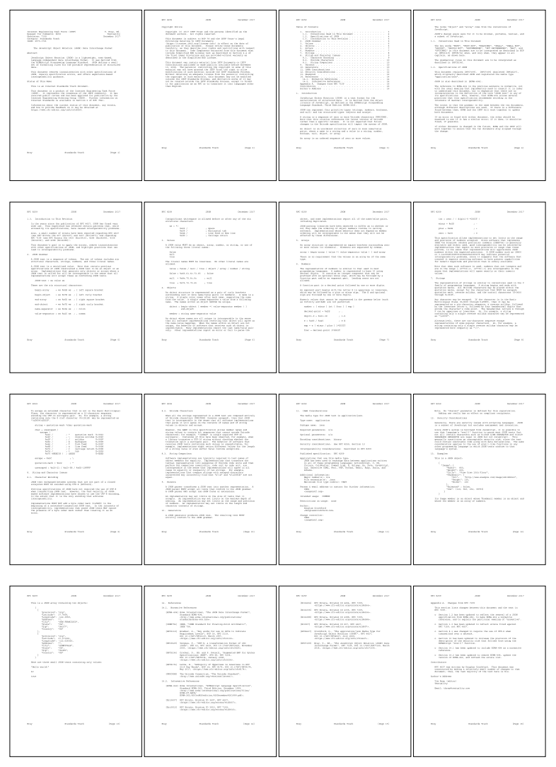
YAML
https://yaml.org/spec/1.2.2/
C++
https://eel.is/c++draft/#gram
entire
RFC 8259

Slide 8
JSON string escaping
text with newline⏎
and "quotation marks"
text with newline\n and \"quotation marks\"

Slide 9
JSON string escaping
Character | Escaped | Description
" | \" | quotation mark U+0022
\ | \\ | reverse solidus U+005C
/ | \/ | solidus U+002F
 | \b | backspace U+0008
 | \f | form feed U+000C
 | \n | line feed U+000A
 | \r | carriage return U+000D
 | \t | tab U+0009
 | \uXXXX | any Unicode character*
Characters that MUST be escaped:
"
\
U+0000..U+001F — control characters

Slide 10
JSON string escaping
RFC 8259 states:
8. String and Character Issues
8.1. Character Encoding
JSON text exchanged between systems that are not part of a closed ecosystem MUST be encoded using UTF-8 [RFC3629].

Slide 11
Considerations for C++ string type
C++17:
char — (usually) 8 bit integer type
namespace std {
using string = basic_string<char, char_traits<char>, allocator<char>>;
}
C++20:
char8_t — (at least) 8 bit integer type able to accommodate UTF-8 code units
namespace std {
using u8string = basic_string<char8_t, char_traits<char8_t>, allocator<char8_t>>;
}
What about interoperability between std::string and std::u8string? 🤷‍♀️

Slide 12
JSON string escaping
enum class Escape {
Default,
NonAscii
};
enum class Utf8Validation {
IgnoreInvalidUtf8CodeUnits,
FailOnInvalidUtf8CodeUnits
};

Slide 13
JSON string escaping
namespace impl {
template<typename Sink>
size_t escape(Sink&&,
const std::string_view&,
Escape,
Utf8Validation);
}
template<typename String_t = std::string>
[[nodiscard]] String_t escape(const std::string_view&,
Escape = {},
Utf8Validation = {});

Slide 14
template<typename String_t = std::string>
[[nodiscard]] String_t escape(const std::string_view &s,
Escape escapeMode = {},
Utf8Validation validation = {}) {
if (!s.empty()) {
String_t res;
if (validation == Utf8Validation::IgnoreInvalidUtf8CodeUnits)
res.reserve(s.size());
using Sink = detail::StringSink<String_t>;
if (impl::escape(Sink{ res }, s, escapeMode, validation) == s.size())
return res;
}
return {};
}
namespace detail {
template<typename String>
struct StringSink final {
void operator()(const std::string_view &t) { s += t; }
String &s;
};
}
std::cout << escape(R"(text with newline
and "quotation marks")");

Slide 15
JSON string escaping
namespace impl {
template<typename Sink>
size_t escape(Sink &&sink,
const std::string_view &s,
Escape escapeMode,
Utf8Validation validation) {
detail::EscapedStringWriter<Sink> writer{ std::forward<Sink>(sink) };
const char *escapedEnd =
writer.write(s.data(), s.data() + s.size(), escapeMode, validation);
return static_cast<size_t>(escapedEnd - s.data());
}
}

Slide 16
JSON string escaping
namespace detail {
template<typename Sink>
struct EscapedStringWriter final {
EscapedStringWriter(Sink &&sink) : sink{ std::forward<Sink>(sink) } {}
const char *write(const char *begin, const char *end,
Escape escape, Utf8Validation validation);
private:
//...
Sink &&sink;
EscapedChar escaped;
const char *pendingBegin;
};
}

Slide 17
const char *write(const char *begin, const char *end,
Escape escape, Utf8Validation validation) {
pendingBegin = begin;
while (pendingBegin != end) {
const char *i = pendingBegin;
for (;;) {
if (const auto esc = matchCommonCharacterToEscape(*i); !esc.empty()) {
writeAndAdvance(i, esc, 1);
break;
}
if ((*i & '\xe0') == 0) { // characters 0x0..0x1f must be escaped
writeAndAdvance(i, escaped.get(*i), 1);
break;
}
++i;
if (i == end) {
writePending(end);
return end;
}
} // for (;;)
} // while ()
return end;
}
f
o
o
\n
b
a
r
\0
pendingBegin
i
characters with short escape sequences
pendingBegin = begin;
while (pendingBegin != end) {
const char *i = pendingBegin;
for (;;) {
//...
} // for (;;)
} // while ()
return end;
control characters

Slide 18
const char *write(const char *begin, const char *end,
Escape escape, Utf8Validation validation) {
pendingBegin = begin;
while (pendingBegin != end) {
const char *i = pendingBegin;
for (;;) {
if (const auto esc = matchCommonCharacterToEscape(*i); !esc.empty()) {
writeAndAdvance(i, esc, 1);
break;
}
if ((*i & '\xe0') == 0) { // characters 0x0..0x1f must be escaped
writeAndAdvance(i, escaped.get(*i), 1);
break;
}
++i;
if (i == end) {
writePending(end);
return end;
}
} // for (;;)
} // while ()
return end;
}
f
o
o
\n
b
a
r
\0
characters with short escape sequences
control characters
for (;;) {
if (const auto esc = matchCommonCharacterToEscape(*i); !esc.empty()) {
writeAndAdvance(i, esc, 1);
break;
}
//...
} // for (;;)

Slide 19
JSON string escaping
namespace detail {
std::string_view matchCommonCharacterToEscape(char c) {
using namespace std::string_view_literals;
switch (c) {
case '\b': return "\\b"sv;
case '\t': return "\\t"sv;
case '\n': return "\\n"sv;
case '\f': return "\\f"sv;
case '\r': return "\\r"sv;
case '\"': return "\\\""sv;
case '\\': return "\\\\"sv;
}
return {};
}
}

Slide 20
const char *write(const char *begin, const char *end,
Escape escape, Utf8Validation validation) {
pendingBegin = begin;
while (pendingBegin != end) {
const char *i = pendingBegin;
for (;;) {
if (const auto esc = matchCommonCharacterToEscape(*i); !esc.empty()) {
writeAndAdvance(i, esc, 1);
break;
}
if ((*i & '\xe0') == 0) { // characters 0x0..0x1f must be escaped
writeAndAdvance(i, escaped.get(*i), 1);
break;
}
++i;
if (i == end) {
writePending(end);
return end;
}
} // for (;;)
} // while ()
return end;
}
f
o
o
\n
b
a
r
\0
control characters
for (;;) {
if (const auto esc = matchCommonCharacterToEscape(*i); !esc.empty()) {
writeAndAdvance(i, esc, 1);
break;
}
//...
} // for (;;)

Slide 21
const char *write(const char *begin, const char *end,
Escape escape, Utf8Validation validation) {
pendingBegin = begin;
while (pendingBegin != end) {
const char *i = pendingBegin;
for (;;) {
if (const auto esc = matchCommonCharacterToEscape(*i); !esc.empty()) {
writeAndAdvance(i, esc, 1);
break;
}
if ((*i & '\xe0') == 0) { // characters 0x0..0x1f must be escaped
writeAndAdvance(i, escaped.get(*i), 1);
break;
}
++i;
if (i == end) {
writePending(end);
return end;
}
} // for (;;)
} // while ()
return end;
}
write pending
f
o
o
\n
b
a
r
\0
void writeAndAdvance(const char *i,
const std::string_view &escapeSequence,
size_t inc) {
if (pendingBegin != i)
writePending(i);
pendingBegin = i + inc;
sink(escapeSequence);
}
void writePending(const char *i) {
sink(std::string_view{ pendingBegin, static_cast<size_t>(i - pendingBegin) });
}

Slide 22
const char *write(const char *begin, const char *end,
Escape escape, Utf8Validation validation) {
pendingBegin = begin;
while (pendingBegin != end) {
const char *i = pendingBegin;
for (;;) {
if (const auto esc = matchCommonCharacterToEscape(*i); !esc.empty()) {
writeAndAdvance(i, esc, 1);
break;
}
if ((*i & '\xe0') == 0) { // characters 0x0..0x1f must be escaped
writeAndAdvance(i, escaped.get(*i), 1);
break;
}
++i;
if (i == end) {
writePending(end);
return end;
}
} // for (;;)
} // while ()
return end;
}
f
o
o
\n
b
a
r
\0
control characters
for (;;) {
if (const auto esc = matchCommonCharacterToEscape(*i); !esc.empty()) {
writeAndAdvance(i, esc, 1);
break;
}
//...
} // for (;;)

Slide 23
const char *write(const char *begin, const char *end,
Escape escape, Utf8Validation validation) {
pendingBegin = begin;
while (pendingBegin != end) {
const char *i = pendingBegin;
for (;;) {
if (const auto esc = matchCommonCharacterToEscape(*i); !esc.empty()) {
writeAndAdvance(i, esc, 1);
break;
}
if ((*i & '\xe0') == 0) { // characters 0x0..0x1f must be escaped
writeAndAdvance(i, escaped.get(*i), 1);
break;
}
++i;
if (i == end) {
writePending(end);
return end;
}
} // for (;;)
} // while ()
return end;
}
write pending
f
o
o
\n
b
a
r
\0
control characters
for (;;) {
//...
if ((*i & '\xe0') == 0) { // characters 0x0..0x1f must be escaped
writeAndAdvance(i, escaped.get(*i), 1);
break;
}
//...
} // for (;;)

Slide 24
namespace detail {
struct EscapedChar final {
std::string_view get(uint16_t c) {
write(buf, c);
return { buf, 6 };
}
private:
static void write(char *p, uint16_t c) {
p[0] = '\\'; p[1] = 'u';
constexpr char digits[] =
{ '0','1','2','3','4','5','6','7','8','9','a','b','c','d','e','f' };
p[2] = digits[c >> 12]; p[3] = digits[(c >> 8) & 0xfu];
p[4] = digits[(c >> 4) & 0xfu]; p[5] = digits[c & 0xfu];
}
char buf[12];
};
}
\0 U+0 → \u0000

Slide 25
const char *write(const char *begin, const char *end,
Escape escape, Utf8Validation validation) {
pendingBegin = begin;
while (pendingBegin != end) {
const char *i = pendingBegin;
for (;;) {
if (const auto esc = matchCommonCharacterToEscape(*i); !esc.empty()) {
writeAndAdvance(i, esc, 1);
break;
}
if ((*i & '\xe0') == 0) { // characters 0x0..0x1f must be escaped
writeAndAdvance(i, escaped.get(*i), 1);
break;
}
++i;
if (i == end) {
writePending(end);
return end;
}
} // for (;;)
} // while ()
return end;
}
write pending
f
o
o
\n
b
a
r
for (;;) {
//...
++i;
if (i == end) {
writePending(end);
return end;
}
} // for (;;)

Slide 26
const char *write(const char *begin, const char *end,
Escape escape, Utf8Validation validation) {
pendingBegin = begin;
while (pendingBegin != end) {
const char *i = pendingBegin;
for (;;) {
if (const auto esc = matchCommonCharacterToEscape(*i); !esc.empty()) {
writeAndAdvance(i, esc, 1);
break;
}
if ((*i & '\xe0') == 0) { // characters 0x0..0x1f must be escaped
writeAndAdvance(i, escaped.get(*i), 1);
break;
}
++i;
if (i == end) {
writePending(end);
return end;
}
} // for (;;)
} // while ()
return end;
}
validation goes here

Slide 27
UTF-8 crash course
UTF-8 code unit |  | encoded code points range
0zzzzzzz | 1 byte code point | U+0000..U+007F
10zzzzzz | continuation code unit
110zzzzz | starts 2 byte code point | U+0080..U+07FF
1110zzzz | starts 3 byte code point | U+0800..U+FFFF
11110zzz | starts 4 byte code point | U+10000..U+10FFFF
 | Unicode code point in binary | UTF-8 code units
$ U+0024 | 00100100 | 00100100
£ U+00A3 | 00000000 10100011 | 11000010 10100011
€ U+20AC | 00100000 10101100 | 11100010 10000010 10101100
🤓 U+1F913 | 01 11111001 00010011 | 11110000 10011111 10100100 10010011

Slide 28
const char *write(const char *begin, const char *end,
Escape escape, Utf8Validation validation) {
//...
for (;;) {
//... common and control character escaping
if (*i & '\x80') { // handling UTF-8 multibyte code point
const size_t codePointSize = detectUtf8CodePointSize(i, end);
if (validation == Utf8Validation::FailOnInvalidUtf8CodeUnits) {
if (codePointSize == 0)
return i;
i += codePointSize;
goto CheckEnd;
}
}
++i;
CheckEnd:
if (i == end) {
writePending(end);
return end;
}
} // for (;;)
//...
}

Slide 29
const char *write(const char *begin, const char *end,
Escape escape, Utf8Validation validation) {
//...
for (;;) {
//... common and control character escaping
if (*i & '\x80') { // handling UTF-8 multibyte code point
const size_t codePointSize = detectUtf8CodePointSize(i, end);
if (validation == Utf8Validation::FailOnInvalidUtf8CodeUnits) {
if (codePointSize == 0)
return i;
i += codePointSize;
goto CheckEnd;
}
}
++i;
CheckEnd:
if (i == end) {
writePending(end);
return end;
}
} // for (;;)
//...
}
if (*i & '\x80') { // handling UTF-8 multibyte code point
const size_t codePointSize = detectUtf8CodePointSize(i, end);
if (validation == Utf8Validation::FailOnInvalidUtf8CodeUnits) {
if (codePointSize == 0)
return i;
i += codePointSize;
goto CheckEnd;
}
}
++i;
CheckEnd:

Slide 30
Typical implementation on the internets
size_t meh_detectUtf8CodepointLength(char c) {
if ((c & 0x80) == 0)
return 1;
if ((c & 0xE0) == 0xC0)
return 2;
if ((c & 0xF0) == 0xE0)
return 3;
if ((c & 0xF8) == 0xF0)
return 4;
return 0;
}
?
?
?
?
?
?

Slide 31
Typical implementation on the internets
size_t meh_detectUtf8CodepointLength(char c) {
if ((c & 0x80) == 0)
return 1;
if ((c & 0xE0) == 0xC0)
return 2;
if ((c & 0xF0) == 0xE0)
return 3;
if ((c & 0xF8) == 0xF0)
return 4;
return 0;
}
?
?
?
?
?
?

Slide 32
JSON string escaping
namespace detail {
template<size_t N>
bool isUtf8CodeUnit(char c) {
constexpr uint8_t mask = static_cast<uint8_t>(0xffu << (7 - N));
constexpr uint8_t pattern = static_cast<uint8_t>(0xffu << (8 - N));
return (mask & static_cast<uint8_t>(c)) == pattern;
}
}
example:
N = 3
mask = 0xffu << (7 - N) = 0b11110000
pattern = 0xffu << (8 - N) = 0b11100000

Slide 33
namespace detail {
size_t getExpectedUtf8CodePointSize(char c) {
if (isUtf8CodeUnit<2>(c)) return 2;
if (isUtf8CodeUnit<3>(c)) return 3;
if (isUtf8CodeUnit<4>(c)) return 4;
return 1;
}
size_t detectUtf8CodePointSize(const char *begin, const char *end) {
const size_t expectedSize = getExpectedUtf8CodePointSize(*begin);
if (expectedSize != 1 &&
static_cast<size_t>(end - begin) >= expectedSize &&
std::all_of(begin + 1, begin + expectedSize, &isUtf8CodeUnit<1>))
return expectedSize;
return 0;
}
}

Slide 34
const char *write(const char *begin, const char *end,
Escape escape, Utf8Validation validation) {
//...
for (;;) {
//... common and control character escaping
if (*i & '\x80') { // handling UTF-8 multibyte code point
const size_t codePointSize = detectUtf8CodePointSize(i, end);
if (escape == Escape::NonAscii) {
//... escape non-ASCII and validate
}
else if (validation == Utf8Validation::FailOnInvalidUtf8CodeUnits) {
//...
}
}
//...
} // for (;;)
//...
}

Slide 35
const char *write(const char *begin, const char *end,
Escape escape, Utf8Validation validation) {
//...
for (;;) {
//... common and control character escaping
if (*i & '\x80') { // handling UTF-8 multibyte code point
const size_t codePointSize = detectUtf8CodePointSize(i, end);
if (escape == Escape::NonAscii) {
//... escape non-ASCII and validate
}
else if (validation == Utf8Validation::FailOnInvalidUtf8CodeUnits) {
//...
}
}
//...
} // for (;;)
//...
}
if (escape == Escape::NonAscii) {
if (codePointSize != 0) {
const auto escapeSequence = std::invoke([this, codePointSize, i] {
switch (codePointSize) {
default: // avoids compilation error
case 2: return escaped.get(gatherBits<uint16_t, 5, 6>(i));
case 3: return escaped.get(gatherBits<uint16_t, 4, 6, 6>(i));
case 4:
return escaped.getSurrogates(gatherBits<uint32_t, 3, 6, 6, 6>(i));
}
});
writeAndAdvance(i, escapeSequence, codePointSize);
break; // for (;;)
}
else if (validation == Utf8Validation::FailOnInvalidUtf8CodeUnits) {
return i;
}
}

Slide 36
Typical implementation on the internets
uint32_t meh_decode4ByteUtf8Codepoint(const char *bytes) {
return
static_cast<char32_t>(bytes[0] & 0b0000'0111) << 18 |
static_cast<char32_t>(bytes[1] & 0b0011'1111) << 12 |
static_cast<char32_t>(bytes[2] & 0b0011'1111) << 06 |
static_cast<char32_t>(bytes[3] & 0b0011'1111);
}
?
?
?

Slide 37
namespace detail {
template<size_t Size>
inline constexpr uint32_t LowerBitsMask = (1u << Size) - 1u;
template<typename Int_t, size_t Size0, size_t... Size1>
Int_t gatherBits(const char *p) {
static_assert((Size0 + ... + Size1) <= sizeof(Int_t) * 8);
const Int_t result = static_cast<Int_t>(*p) & LowerBitsMask<Size0>;
if constexpr (sizeof...(Size1) == 0) {
return result;
}
else {
return
(result << (Size1 + ...)) | gatherBits<Int_t, Size1...>(p + 1);
}
}
}
3
0b00000111 (0x7)
3
6, 6, 6
*p == 0b11110000 (0xF0)
result = *p & 0x7
6 + 6 + 6 = 18
6, 6, 6

Slide 38
UTF-16 surrogates crash course
UTF-8 code unit |  | encoded code points range
…
11110zzz | starts 4 byte code point | U+10000..U+10FFFF
\uXXXX on its own can only encode code points up to U+FFFF
17 bits
21 bits
16 bits
UTF-16 code unit |  | range of values
110110zz zzzzzzzz | high surrogate | 0xD800..0xDBFF
110111zz zzzzzzzz | low surrogate | 0xDC00..0xDFFF
 | Unicode code point in binary | UTF-16 surrogate pair code units
🤓 U+1F913 | 0001 11111001 00010011 | 11011000 00111110 11011101 00010011

Slide 39
namespace detail {
struct EscapedChar final {
std::string_view get(uint16_t c) {
write(buf, c);
return { buf, 6 };
}
std::string_view getSurrogates(uint32_t c) {
const uint32_t surrogate = c - 0x10000u;
write(buf, static_cast<uint16_t>((surrogate >> 10) | 0xd800u));
write(buf + 6,
static_cast<uint16_t>(surrogate & LowerBitsMask<10> | 0xdc00u));
return { buf, 12 };
}
private:
//...
char buf[12];
};
}
17 bits 21 bits
c ∊ [ 0x10000..0x10FFFF ]
1 bit 20 bits
(c – 0x10000) ∊ [ 0x0..0xFFFFF ]
🤓 U+1F913 → \ud83e\udd13

Slide 40
const char *write(const char *begin, const char *end,
Escape escape, Utf8Validation validation) {
//...
//... common and control character escaping
if (*i & '\x80') { // handling UTF-8 multibyte code point
const size_t codePointSize = detectUtf8CodePointSize(i, end);
if (escape == Escape::NonAscii) {
if (codePointSize != 0) {
//...
}
else if (validation == Utf8Validation::FailOnInvalidUtf8CodeUnits) {
return i;
}
}
else if (validation == Utf8Validation::FailOnInvalidUtf8CodeUnits) {
//...
}
}
//...
}
if (*i & '\x80') {

Slide 41
JSON string escaping
namespace detail {
template<typename Sink>
struct EscapedStringWriter final {
//...
private:
enum Mode {
Default = 0,
EscapeNonAscii = 1,
ValidateUtf8 = 1 << 1,
EscapeNonAsciiAndValidateUtf8 = EscapeNonAscii | ValidateUtf8
};
//...
};
}

Slide 42
JSON string escaping
namespace detail {
template<typename Sink>
struct EscapedStringWriter final {
//...
private:
//...
template<Mode mode>
const char *writeImpl(const char *begin, const char *end) {
//...
}
//...
};
}

Slide 43
template<Mode mode>
const char *writeImpl(const char *begin, const char *end) {
//...
//... common and control character escaping
if constexpr (mode != Default) {
if (*i & '\x80') { // handling UTF-8 multibyte code point
const size_t codePointSize = detectUtf8CodePointSize(i, end);
if constexpr (mode & EscapeNonAscii) {
if (codePointSize != 0) {
//...
}
else if constexpr (mode & ValidateUtf8) {
//...
}
}
else /* mode == ValidateUtf8 */ {
//...
}
}
}
//...
}

Slide 44
template<Mode mode>
const char *writeImpl(const char *begin, const char *end) {
//...
//... common and control character escaping
if constexpr (mode != Default) {
if (*i & '\x80') { // handling UTF-8 multibyte code point
const size_t codePointSize = detectUtf8CodePointSize(i, end);
if constexpr (mode & EscapeNonAscii) {
if (codePointSize != 0) {
//...
}
else if constexpr (mode & ValidateUtf8) {
//...
}
}
else /* mode == ValidateUtf8 */ {
//...
}
}
}
//...
}
if constexpr (mode != Default) {
if (*i & '\x80') { // handling UTF-8 multibyte code point
const size_t codePointSize = detectUtf8CodePointSize(i, end);
if constexpr (mode & EscapeNonAscii) {
if (codePointSize != 0) {
//...
}
else if constexpr (mode & ValidateUtf8) {
//...
}
}
else /* mode == ValidateUtf8 */ {
//...
}
}
}

Slide 45
namespace detail {
template<typename Sink>
struct EscapedStringWriter final {
//...
const char *write(const char *begin, const char *end,
Escape escape, Utf8Validation validation) {
if (escape == Escape::Default) {
return validation == Utf8Validation::FailOnInvalidUtf8CodeUnits ?
writeImpl<ValidateUtf8>(begin, end) :
writeImpl<Default>(begin, end);
}
return validation == Utf8Validation::FailOnInvalidUtf8CodeUnits ?
writeImpl<EscapeNonAsciiAndValidateUtf8>(begin, end) :
writeImpl<EscapeNonAscii>(begin, end);
}
//...
};
}

Slide 46
JSON string escaping
// "$ \xc2\xa3 \xe2\x82\xac \xf0\x9f\xa4\x93"sv;
const auto text = "$ £ € 🤓"sv;
std::cout << escape(text) << '\n';
std::cout << escape(text, Escape::EscapeNonAscii) << '\n';
output:
$ £ € 🤓
$ \u00a3 \u20ac \ud83e\udd13

Slide 47
Thanks for listening

Slide 48
minjsoncpp
Minimalistic JSON C++ library
https://github.com/toughengineer/minjsoncpp

Slide 49
JSON in C++: escaping and serialization
Pavel Novikov
@cpp_ape
Slides: bit.ly/3Wv28mV

Slide 50
Mapping of JSON types into C++
JSON |  | C++
null | null
boolean | true or false | bool
number | 3.14 | int64_t, double
string | "hello" | std::string
array | [ 1, 2, 3 ] | std::vector<Value>
object | { "key": "value" } | std::unordered_map<std::string, Value>
keys are unordered

Slide 51
Mapping of JSON types into C++
JSON value is a union type
std::variant<std::monostate,
bool,
int64_t,
double,
std::string,
std::vector<Value>,
std::unordered_map<String, Value>>
null

Slide 52
Value type
struct Value {
using Null = std::monostate;
using Boolean = bool;
using String = std::string;
using Array = std::vector<Value>;
using Object = std::unordered_map<String, Value>;
using Variant =
std::variant<Null, Boolean, int64_t, double, String, Array, Object>;
//...
private:
//...
Variant m_data;
};

Slide 53
Value type
struct Value {
//...
[[nodiscard]] const Variant &variant() const& noexcept { return m_data; }
[[nodiscard]] Variant &variant() & noexcept { return m_data; }
[[nodiscard]] Variant &&variant() && noexcept {
return std::move(m_data);
}
[[nodiscard]] const Variant &&variant() const&& noexcept {
return std::move(m_data);
}
//...
};

Slide 54
Serialization
{
}
We need a stack structure.
recursion, i.e. call stack
can use stack space inefficiently
structure on program stack
can waste program stack space
structure on the heap
memory allocation expenses
"null":null,
"boolean":true,
"integer":42,
"decimal":3.14,
"string":"hello",
"array":[
]
1,
2,
3
"nested object":{
},
"foo":"bar"

Slide 55
Serialization
constexpr std::string_view NullLiteral{ "null" };
constexpr std::string_view FalseLiteral{ "false" };
constexpr std::string_view TrueLiteral{ "true" };

Slide 56
Serialization
struct SerializationOptions {
size_t indent = 0;
Escape escape = {};
Utf8Validation validation = {};
std::string_view newlineSeparator = {};
bool sortObjectKeys = false;
//...
};

Slide 57
struct SerializationOptions {
//...
std::string_view nullLiteral = NullLiteral;
std::string_view falseLiteral = FalseLiteral;
std::string_view trueLiteral = TrueLiteral;
std::string_view emptyObject = "{}";
std::string_view objectOpeningBrace = "{";
std::string_view objectClosingBrace = "}";
std::string_view objectKeyValueSeparator = ":";
std::string_view objectMemberSeparator = ",";
std::string_view emptyArray = "[]";
std::string_view arrayOpeningBracket = "[";
std::string_view arrayClosingBracket = "]";
std::string_view arrayMemberSeparator = ",";
std::string_view openingStringQuotation = "\"";
std::string_view closingStringQuotation = "\"";
};

Slide 58
namespace impl {
template<typename Sink>
void serialize(Sink &&sink,
const Value &v,
const SerializationOptions &options,
size_t initialIndentation = 0) {
//...
}
void serializeToStream(std::ostream &s, const Value &v, const SerializationOptions &o = {}) {
impl::serialize(detail::StdOStreamSink{ s }, v, o);
}
[[nodiscard]] Value::String serializeToString(const Value &v,
const SerializationOptions &o = {}) {
Value::String s;
impl::serialize(detail::StringSink<Value::String>{ s }, v, o);
return s;
}

Slide 59
namespace detail {
struct StdOStreamSink final {
void operator()(const std::string_view &v) const {
s.write(v.data(), v.size());
}
std::ostream &s;
};
}
namespace impl {
template<typename Sink>
void serialize(Sink &&sink,
const Value &v,
const SerializationOptions &options,
size_t initialIndentation = 0) {
//...
}
void serializeToStream(std::ostream &s, const Value &v, const SerializationOptions &o = {}) {
impl::serialize(detail::StdOStreamSink{ s }, v, o);
}
[[nodiscard]] Value::String serializeToString(const Value &v,
const SerializationOptions &o = {}) {
Value::String s;
impl::serialize(detail::StringSink<Value::String>{ s }, v, o);
return s;
}
void serializeToStream(std::ostream &s,
const Value &v,
const SerializationOptions &o = {}) {
impl::serialize(detail::StdOStreamSink { s }, v, o);
}
[[nodiscard]]
Value::String serializeToString(const Value &v,
const SerializationOptions &o = {}) {
Value::String s;
impl::serialize(detail::StringSink<Value::String>{ s }, v, o);
return s;
}

Slide 60
namespace impl {
template<typename Sink>
void serialize(Sink &&sink,
const Value &v,
const SerializationOptions &o,
size_t initialIndent = 0) {
using Visitor = detail::SerializingVisitor<Sink>;
if (o.indent || !o.newlineSeparator.empty()) {
const std::string_view newlineSeparator =
o.newlineSeparator.empty() ? "\n" : o.newlineSeparator;
std::visit(
Visitor{ std::forward<Sink>(sink), o, newlineSeparator, initialIndent },
v.variant());
}
else {
std::visit(
Visitor{ std::forward<Sink>(sink), o, {}, 0 },
v.variant());
}
}
}

Slide 61
namespace impl {
template<typename Sink>
void serialize(Sink &&sink,
const Value &v,
const SerializationOptions &o,
size_t initialIndent = 0) {
using Visitor = detail::SerializingVisitor<Sink>;
if (o.indent || !o.newlineSeparator.empty()) {
const std::string_view newlineSeparator =
o.newlineSeparator.empty() ? "\n" : o.newlineSeparator;
std::visit(
Visitor{ std::forward<Sink>(sink), o, newlineSeparator, initialIndent },
v.variant());
}
else {
std::visit(
Visitor{ std::forward<Sink>(sink), o, {}, 0 },
v.variant());
}
}
}
using Visitor = detail::SerializingVisitor<Sink>;
if (o.indent || !o.newlineSeparator.empty()) {
const std::string_view newlineSeparator =
o.newlineSeparator.empty() ? "\n" : o.newlineSeparator;
std::visit(
Visitor{ std::forward<Sink>(sink), o, newlineSeparator, initialIndent },
v.variant());
}
else {
std::visit(
Visitor{ std::forward<Sink>(sink), o },
v.variant());
}

Slide 62
namespace detail {
template<typename Sink>
struct SerializingVisitor final {
void operator()(const typename Value::Object &o) {/*...*/}
void operator()(const typename Value::Array &a) {/*...*/}
void operator()(const typename Value::String &t) {/*...*/}
void operator()(double d) {/*...*/}
void operator()(int64_t i) {/*...*/}
void operator()(Boolean b) {/*...*/}
void operator()(Null) {/*...*/}
Sink &&sink;
const SerializationOptions &options;
const std::string_view newlineSeparator;
size_t indentation;
private:
//...
};
}

Slide 63
Serialization
namespace detail {
template<typename Sink>
struct SerializingVisitor final {
//...
void operator()(double d) {
char buf[24];
const auto result = std::to_chars(buf, buf + sizeof(buf), d);
const size_t size = static_cast<size_t>(result.ptr - buf);
sink(std::string_view{ buf, size });
}
//...
};
}
std::to_chars() gives shortest representation without loss of precision, e.g
1234.5678
not
1234.567800000000033833202905952930450439453125

Slide 64
Serialization
namespace detail {
template<typename Sink>
struct SerializingVisitor final {
//...
void operator()(const typename Value::String &t) { writeString(t); }
//...
private:
void writeString(const std::string_view &s) const {
//...
}
//...
};
}

Slide 65
void writeString(const std::string_view &s) const {
sink(options.openingStringQuotation);
const size_t escapedSize =
impl::escape(sink, s, options.escape, options.validation);
if (options.validation == Utf8Validation::FailOnInvalidUtf8CodeUnits &&
escapedSize != s.size()) {
const size_t expectedCodePointSize =
getExpectedUtf8CodePointSize(s[escapedSize]);
const size_t reportedSize =
std::min(expectedCodePointSize, s.size() - escapedSize);
throw InvalidUtf8CodeUnitsError{ "invalid UTF-8 code units",
s.substr(escapedSize, reportedSize),
escapedSize };
}
sink(options.closingStringQuotation);
}
"
hello
"
most reasonable way
to report an error
in this case

Slide 66
Serialization
struct InvalidUtf8CodeUnitsError : std::runtime_error {
InvalidUtf8CodeUnitsError(const char *msg,
const std::string_view &codeUnits,
size_t offset) :
runtime_error{ msg },
codeUnits{ codeUnits },
offset{ offset }
{}
const std::string codeUnits;
const size_t offset;
};
forbids noexcept copy ctor

Slide 67
Serialization
namespace detail {
template<typename Sink>
struct SerializingVisitor final {
//...
void operator()(const typename Value::Object &o) {/*...*/}
//...
private:
//...
};
}

Slide 68
Serialization
void operator()(const typename Value::Object &o) {
if (o.empty() && !options.emptyObject.empty()) {
sink(options.emptyObject);
return;
}
sink(options.objectOpeningBrace);
indentation += options.indent;
writeNewlineAndIndentation();
//...
}
{}
{⏎
··

Slide 69
void operator()(const typename Value::Object &o) {
//...
if (o.size() == 1) {
writeObjectMember(*o.begin());
}
else if (options.sortObjectKeys) {
// ???
std::sort(items.begin(), items.end(),
/* ??? */);
writeObjectMembers(items.begin(), items.end());
}
else {
writeObjectMembers(o.begin(), o.end());
}
//...
}
{
"foo":"bar"

Slide 70
Serialization
void operator()(const typename Value::Object &o) {
//...
indentation -= options.indent;
writeNewlineAndIndentation();
sink(options.objectClosingBrace);
}
{
"foo":"bar"
}

Slide 71
void operator()(const typename Value::Object &o) {
//...
if (o.size() == 1) {
writeObjectMember(*o.begin());
}
else if (options.sortObjectKeys) {
// ???
std::sort(items.begin(), items.end(),
/* ??? */);
writeObjectMembers(items.begin(), items.end());
}
else {
writeObjectMembers(o.begin(), o.end());
}
//...
}

Slide 72
namespace detail {
template<typename Sink>
struct SerializingVisitor final {
//...
private:
//...
template<typename Iterator>
void writeObjectMembers(Iterator begin, const Iterator &end) {
writeObjectMember(*begin);
for (++begin; begin != end; ++begin) {
sink(options.objectMemberSeparator);
writeNewlineAndIndentation();
writeObjectMember(*begin);
}
}
//...
};
}

Slide 73
namespace detail {
template<typename Sink>
struct SerializingVisitor final {
//...
private:
//...
void writeObjectMember(const typename Value::Object::value_type &i) {
const auto &[key, value] = i;
writeString(key);
sink(options.objectKeyValueSeparator);
std::visit(*this, value.variant());
}
//...
};
}
possible recursion

Slide 74
void operator()(const typename Value::Object &o) {
//...
if (o.size() == 1) {
writeObjectMember(*o.begin());
}
else if (options.sortObjectKeys) {
// ???
std::sort(items.begin(), items.end(),
/* ??? */);
writeObjectMembers(items.begin(), items.end());
}
else {
writeObjectMembers(o.begin(), o.end());
}
//...
}

Slide 75
void operator()(const typename Value::Object &o) {
//...
else if (options.sortObjectKeys) {
using ReferenceWrapper =
std::reference_wrapper<const typename Value::Object::value_type>;
std::vector<ReferenceWrapper> items{ o.begin(), o.end() };
std::sort(items.begin(), items.end(),
[](auto a, auto b) {
// ???
});
writeObjectMembers(items.begin(), items.end());
}
//...
}

Slide 76
void operator()(const typename Value::Object &o) {
//...
else if (options.sortObjectKeys) {
using ReferenceWrapper =
std::reference_wrapper<const typename Value::Object::value_type>;
std::vector<ReferenceWrapper> items{ o.begin(), o.end() };
std::sort(items.begin(), items.end(),
[](auto a, auto b) {
return std::get<0>(a.get()) < std::get<0>(b.get());
});
writeObjectMembers(items.begin(), items.end());
}
//...
}

Slide 77
namespace detail {
template<typename Sink>
struct SerializingVisitor final {
void operator()(const typename Value::Object &o) {/*...*/}
void operator()(const typename Value::Array &a) {/*...*/}
void operator()(const typename Value::String &t) {/*...*/}
void operator()(double d) {/*...*/}
void operator()(int64_t i) {/*...*/}
void operator()(Boolean b) {/*...*/}
void operator()(Null) {/*...*/}
Sink &&sink;
const SerializationOptions &options;
const std::string_view newlineSeparator;
size_t indentation;
private:
//...
};
}

Slide 78
Serialization
std::cout << serializeToString(json);
output:
{"decimal":3.14,"null":null,"boolean":true,"nested object":{"foo":"bar"},"integer":42,"string":"hello","array":[1,2,1234.5678]}

Slide 79
Serialization
std::cout << serializeToString(json, { 2 });
output:
{
"decimal":3.14,
"null":null,
"boolean":true,
"nested object":{
"foo":"bar"
},
"integer":42,
"string":"hello",
"array":[
1,
2,
1234.5678
]
}
indent

Slide 80
Serialization
SerializationOptions options;
options.indent = 2;
options.sortObjectKeys = true;
serializeToStream(std::cout, json, options);
output:
{
"array":[
1,
2,
1234.5678
],
"boolean":true,
"decimal":3.14,
"integer":42,
"nested object":{
"foo":"bar"
},
"null":null,
"string":"hello"
}

Slide 81
Serialization
SerializationOptions options;
options.indent = 2;
serializeToStream(std::cout, json, options);
output:
{
"decimal":3.14,
"null":null,
"boolean":true,
"nested object":{
"foo":"bar"
},
"integer":42,
"string":"hello",
"array":[
1,
2,
1234.5678
]
}

Slide 82
Serialization
SerializationOptions options;
options.indent = 2;
options.objectKeyValueSeparator = ": ";
serializeToStream(std::cout, json, options);
output:
{
"decimal": 3.14,
"null": null,
"boolean": true,
"nested object": {
"foo": "bar"
},
"integer": 42,
"string": "hello",
"array": [
1,
2,
1234.5678
]
}

Slide 83
SerializationOptions options;
options.indent = 2;
options.nullLiteral = "\x1b[90mnull\x1b[0m";
options.falseLiteral = "\x1b[96mfalse\x1b[0m";
options.trueLiteral = "\x1b[96mtrue\x1b[0m";
options.emptyObject = "\x1b[91m{}\x1b[0m";
options.objectOpeningBrace = "\x1b[91m{\x1b[0m";
options.objectClosingBrace = "\x1b[91m}\x1b[0m";
options.objectKeyValueSeparator = "\x1b[31m:\x1b[0m ";
options.objectMemberSeparator = "\x1b[31m,\x1b[0m";
options.emptyArray = "\x1b[95m[]\x1b[0m";
options.arrayOpeningBracket = "\x1b[95m[\x1b[0m";
options.arrayClosingBracket = "\x1b[95m]\x1b[0m";
options.arrayMemberSeparator = "\x1b[35m,\x1b[0m";
options.openingStringQuotation = "\x1b[90m\"\x1b[97m";
options.closingStringQuotation = "\x1b[90m\"\x1b[0m";
serializeToStream(std::cout, json, options);
{ "decimal": 3.14, "null": null, "boolean": true, "nested object": { "foo": "bar" }, "integer": 42, "string": "hello", "array": [ 1, 2, 1234.5678 ] }

Slide 84
SerializationOptions options;
options.indent = 2;
options.nullLiteral = R"(<span style="color: gray;">null</span>)"sv;
options.falseLiteral = R"(<span style="color: blue;">false</span>)"sv;
options.trueLiteral = R"(<span style="color: blue;">true</span>)"sv;
options.emptyObject = R"(<span style="color: red;">{}</span>)"sv;
options.objectOpeningBrace = R"(<span style="color: red;">{</span>)"sv;
options.objectClosingBrace = R"(<span style="color: red;">}</span>)"sv;
options.objectKeyValueSeparator = R"(<span style="color: darkred;">: </span>)"sv;
options.objectMemberSeparator = R"(<span style="color: darkred;">,</span>)"sv;
options.emptyArray = R"(<span style="color: magenta;">[]</span>)"sv;
options.arrayOpeningBracket = R"(<span style="color: magenta;">[</span>)"sv;
options.arrayClosingBracket = R"(<span style="color: magenta;">]</span>)"sv;
options.arrayMemberSeparator = R"(<span style="color: darkmagenta;">,</span>)"sv;
options.openingStringQuotation = R"(<span style="color: lightgray;">"</span><span style="color: teal;">)"sv;
options.closingStringQuotation = R"(</span><span style="color: lightgray;">"</span>)"sv;
serializeToStream(std::cout, json, options);
output:
<span style="color: red;">{</span>
<span style="color: lightgray;">"</span><span style="color: teal;">decimal</span><span style="color: lightgray;">"</span><span style="color: darkred;">: </span>3.14<span style="color: darkred;">,</span>
<span style="color: lightgray;">"</span><span style="color: teal;">null</span><span style="color: lightgray;">"</span><span style="color: darkred;">: </span><span style="color: gray;">null</span><span style="color: darkred;">,</span>
<span style="color: lightgray;">"</span><span style="color: teal;">boolean</span><span style="color: lightgray;">"</span><span style="color: darkred;">: </span><span style="color: blue;">true</span><span style="color: darkred;">,</span>
<span style="color: lightgray;">"</span><span style="color: teal;">nested object</span><span style="color: lightgray;">"</span><span style="color: darkred;">: </span><span style="color: red;">{</span>
<span style="color: lightgray;">"</span><span style="color: teal;">foo</span><span style="color: lightgray;">"</span><span style="color: darkred;">: </span><span style="color: lightgray;">"</span><span style="color: teal;">bar</span><span style="color: lightgray;">"</span>
<span style="color: red;">}</span><span style="color: darkred;">,</span>
<span style="color: lightgray;">"</span><span style="color: teal;">integer</span><span style="color: lightgray;">"</span><span style="color: darkred;">: </span>42<span style="color: darkred;">,</span>
<span style="color: lightgray;">"</span><span style="color: teal;">string</span><span style="color: lightgray;">"</span><span style="color: darkred;">: </span><span style="color: lightgray;">"</span><span style="color: teal;">hello</span><span style="color: lightgray;">"</span><span style="color: darkred;">,</span>
<span style="color: lightgray;">"</span><span style="color: teal;">array</span><span style="color: lightgray;">"</span><span style="color: darkred;">: </span><span style="color: magenta;">[</span>
1,
2,
1234.5678
<span style="color: magenta;">]</span>
<span style="color: red;">}</span>

Slide 85
Serialization
{
"decimal": 3.14,
"null": null,
"boolean": true,
"nested object": {
"foo": "bar"
},
"integer": 42,
"string": "hello",
"array": [
1,
2,
1234.5678
]
}
rendered HTML

Slide 87
References
RFC 8259: The JavaScript Object Notation (JSON) Data Interchange Format https://datatracker.ietf.org/doc/html/rfc8259
ANSI escape code: Colors https://en.wikipedia.org/wiki/ANSI_escape_code#Colors
minjsoncpp — Minimalistic JSON C++ library https://github.com/toughengineer/minjsoncpp

